Slide 1
ManyCore on handhelds
September 9, 2010
Seungwon Lee@SAIT

Slide 2
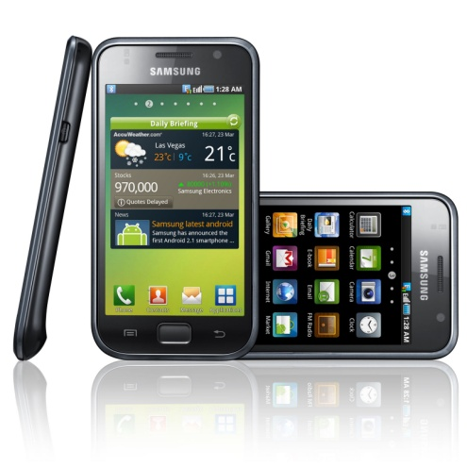
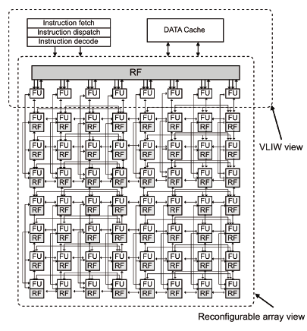
Prologue

Slide 3
Motivation
Can Handheld Offer Laptop Experience?
For a decent mobile device, we need
Display: at least 1024X768
Input: keyboard-like rate
Network: 50Mbps

Slide 4
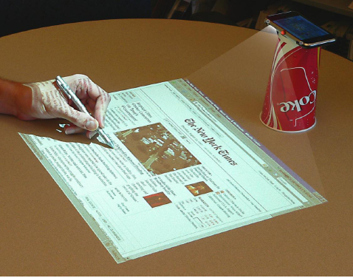
A joke or near reality?
A man walks into a bar, asks for a cup and start his browser

Slide 5
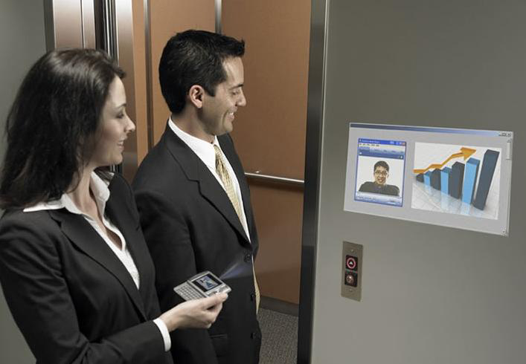
Display: Picoprojector
www.microvision.com

Slide 6
Input: Whiteboard recorder
microphones
light sensor
How it works:
Triangulates in the same way that scouts measure lightning distance
www.mimio.com

Slide 7
Other display alternatives
Foldable displays
OLED based
Wearable display: olympus.com, 22Moo.com
Rapidly getting smaller
Classical display (or MS Surface) installed in offices, cafes
Compared to public PCs, adds personalization
They could acts as display to your handheld

Slide 8
Other input alternatives
Speech recognition
We’ll have enough MIPS for low-noise environment
Google android support speech recognition
Sensors for gestures
iPhone has sensors: ex, to zoom into a map
Virtual laser keyboard

Slide 9
And finally the network
4G Cellular Netwokrs:
4G CDMA
Over 275 Mbit/s download and over 75 Mbit/s upstream
4G GSM/UMTS
Download rates of 100 Mbit/s, and upload rates of 50Mbit/s
Last broadband
WiMAX
70Mbit/s upstream and downstream

Slide 10
Have we got all enabling tech?
Display: many alternatives
Input: half as many
Network: plenty fast soon (if we get better provides)
How about computing power?
CPU speed no longer considered a reason to upgrade your PC

Slide 11
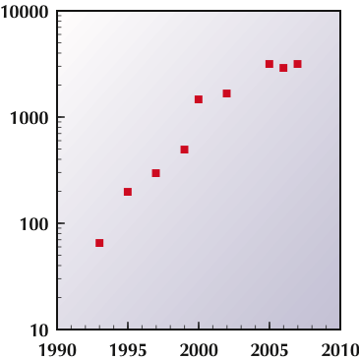
Increasing Performance of Microprocessors
“In the past, performance scaling in conventional single-core processors has been accomplished largely through increases in clock frequency (accounting for roughly 80 percent of the performance gains to date).”
Platform 2015
S. Y. Borkar et al., 2006
Intel Corporation
Frequency (MHz)
Intel Pentium

Slide 12
Problem with Uni-core Microprocessors
Rocket Nozzle
1000
Nuclear Reactor
Pentium 4
(Prescott)
100
Pentium 4
(Willamette)
Watts/cm²
Hot Plate
Pentium III
10
Pentium II
Pentium Pro
i386
Pentium
i486
1
1.5m
1.0m
0.7m
0.5m
0.35m
0.25m
0.18m
0.13m
0.1m
0.07m
Decreasing Feature Size
Increasing Chip Frequency

Slide 13
From Uni-core to Multi-core Processors
Intel’s Nehalem
Modular
Up to 8 cores
3 levels of cache
Integrated memory controller
Multiple QuickPath Interconnects

Slide 14
Switch to Multicore Chips
“For the next several years the only way to obtain significant increases in microprocessor performance will be through increasing use of parallelism:
– 8× in 2009-10,
– 16× in 2011-12,
– and so on
dual core
quad core
Frequency (MHz)

Slide 15
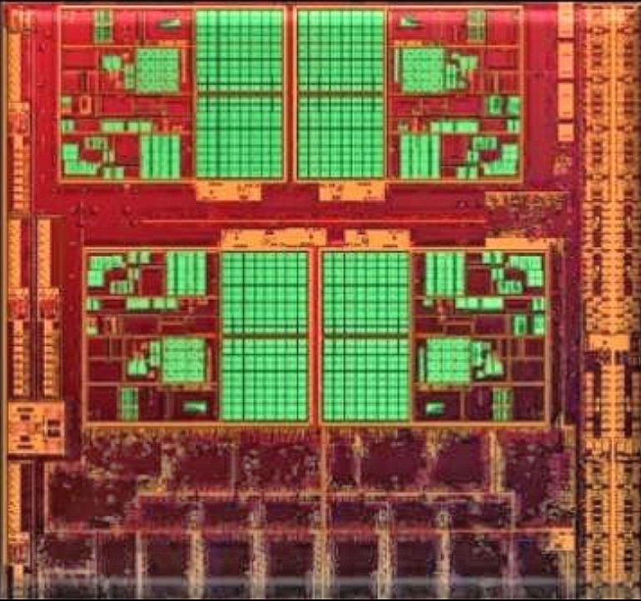
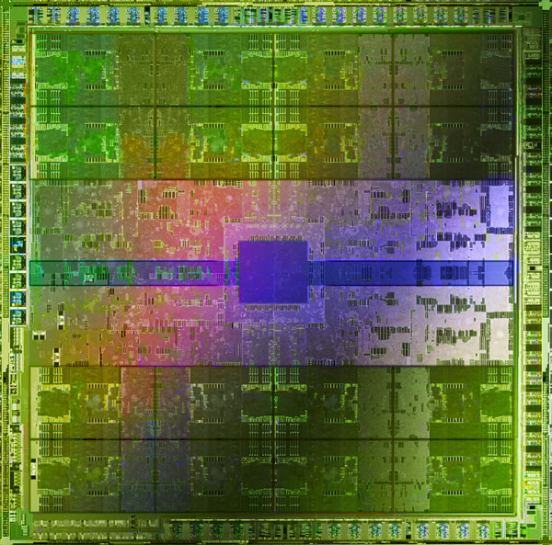
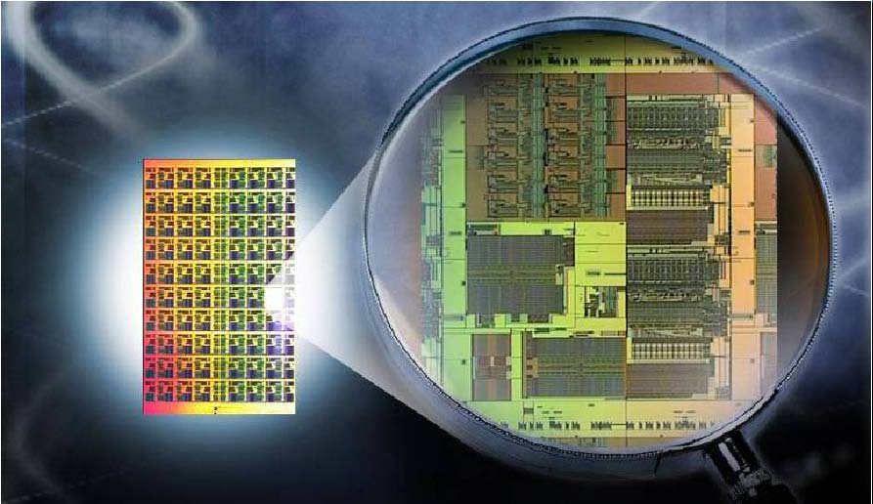
On to Many-core Chips
AMD Llano
(4 x86 cores + 480
stream processors)
NVIDIA Fermi
(512 cores)
Intel Teraflops Chip
(80 cores)
Intel Many Integrated Cores
(>80 x86+ cores)

Slide 16
Recent Evolution of NVIDIA GPUs
GPU: | G80 | GT200 | Fermi
Transistors | 681 million | 1,400 million | 3,000 million
CUDA Cores | 128 | 240 | 512
DP Floating Point | None | 30 FMA/cycle | 256 FMA/cycle
SP Floating Point | 128 MAD/cycle | 240 MAD/cycle | 512 FMA/cycle
Shared Memory | 16 KB/SM | 16 KB/SM | 16 or 48 KB/SM
L1 Cache | None | None | 16 or 48 KB/SM
L2 Cache | None | None | 768 KB
ECC Memory | No | No | Yes
Address Width | 32-bit | 32-bit | 64-bit
Peak DP performance = 256 FMA/cycle x 2 flops/FMA x 1.5 GHz = 768 GF
Peak SP performance = 512 FMA/cycle x 2 flops/FMA x 1.5 GHz = 1,536 GF

Slide 17
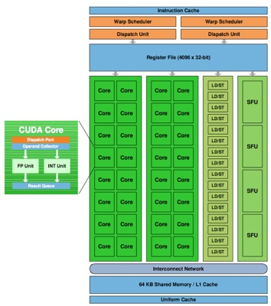
Fermi Streaming Multiprocessor Architecture
Streaming Multiprocessor
16 SMs per chip
Each SM has:
32 CUDA cores
Floating point and integer units for each core
Fused multiply-add instruction
16 load-store units
4 special function units
Transcendental functions (sin, cos, reciprocal, square root)

Slide 18
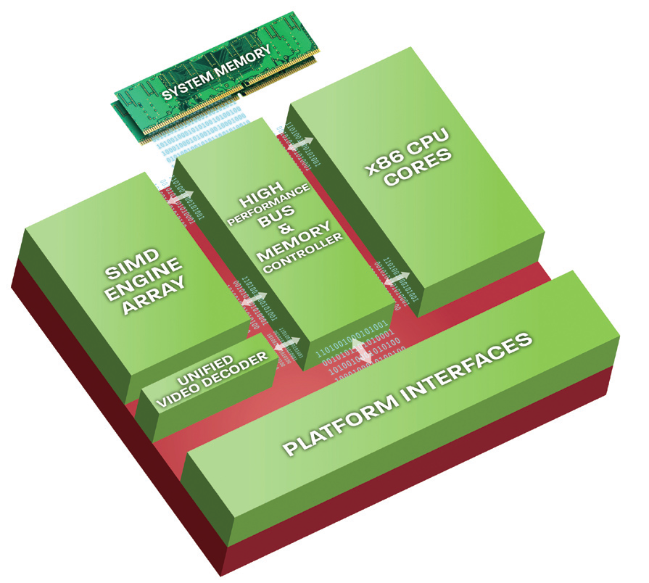
AMD’s Fusion “Application Processing Unit”
Heterogeneous Architecture
x86 cores
Streaming processors
High Performance Interconnect
High Performance Memory Controller

Slide 19
Collision or Convergence?
CPU
?
multi-threading
multi-core
many-core
fully programmable
programmability
partially programmable
parallelism
fixed function
GPU

Slide 20
Take Home Lessons
Examine New Computing Technologies
Computers of future will be based on many-core chips
Details TBD, but may be heterogeneous
Focus on Scalable Algorithms
Only significant speed gains in future will come through increased parallelization
Explore New Programming Models
Computing systems will be (are!) collections of SMPs
Need to assess and improve MPI/OpenMP, OpenCL, CUDA, GCD
Enhance Reliability
Systems level (e.g., virtualization)
Applications level

Slide 21
Epilogue
A joke?
A near reality?

