Slide 1
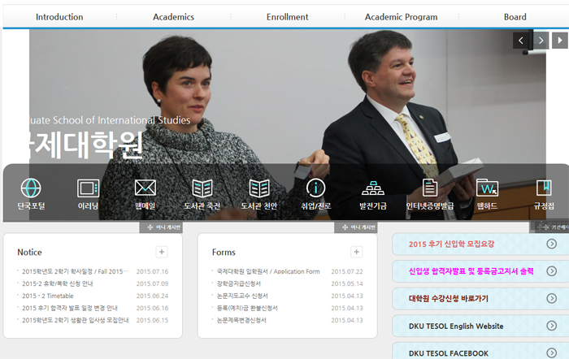
Course registration
1. Open the homepage
< http://cms.dankook.ac.kr/web/ginter >
2. [대학원 수강신청 바로가기] click

Slide 2
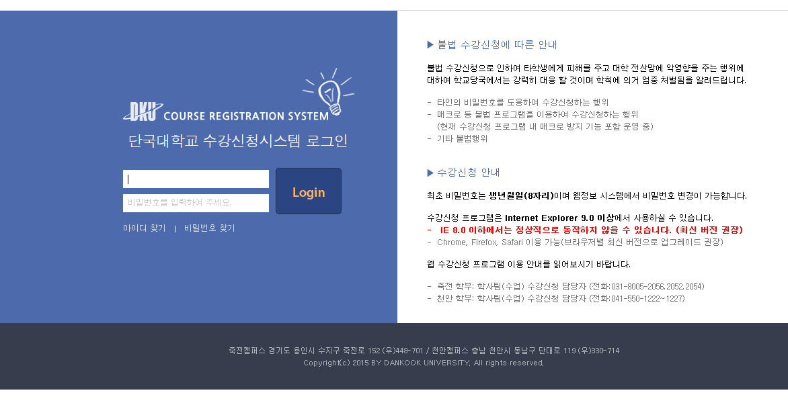
Course registration
3. Input your ID / PASSWORD
Your Password is 8 digits of your birthday. (if you didn’t change before)
Ex)19910923

Slide 3
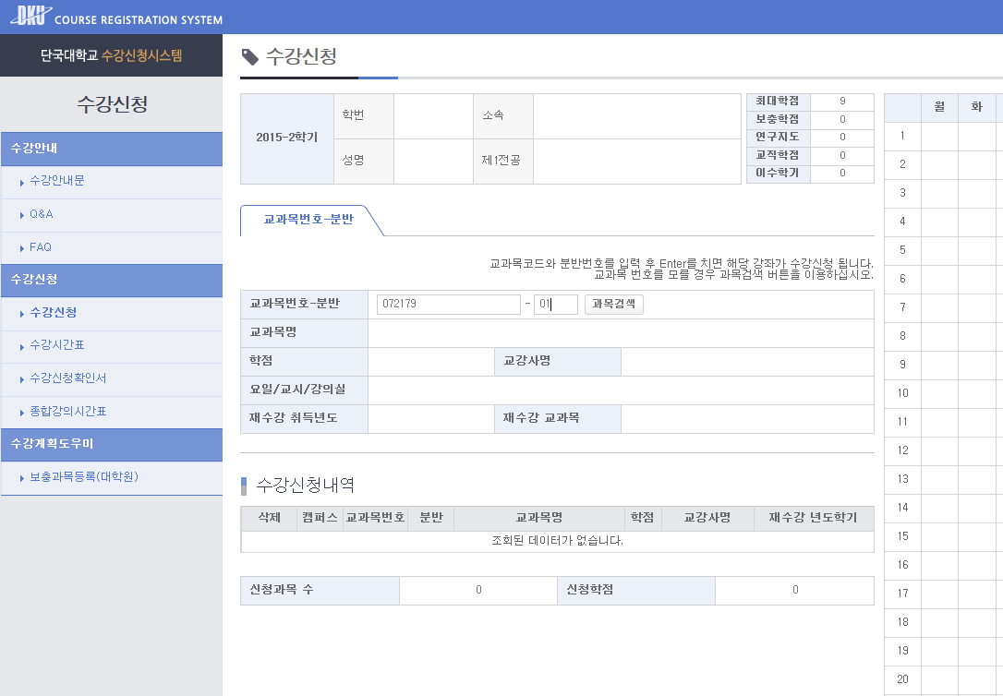
Course registration
4. Check your info
(major/student number/name)
5. Please input Subject code(과목코드) & 분반(01) and press the ‘Enter’ key on keyboard.
(you can find both from timetable)

Slide 4
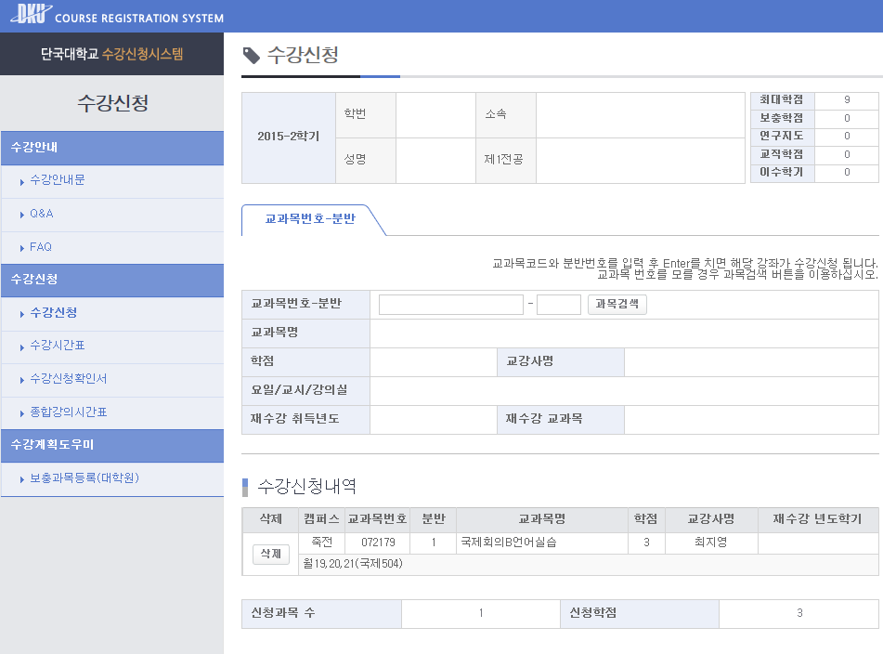
Course registration
6. You can see your subject on
[수강신청내역]
7. Register for each class you would like to select in the same way.

Slide 5
Course registration
8. If you didn’t register for your class in the official registration period, space permitting you can register or change at [course registration Drop & Add period] too.
9. You can see information on the textbook, etc. at the first class of each subject.
10. Colloquium – required for all students
Core courses (2 out of 4 Courses)
Methods in TESOL TESOL Research
Second Language Acquisition Second Language Assessment

