Slide 1
A New Index of Risk Aversion*
Beum-Jo Park and Hong Chong Cho
Dankook University
The Research Institute of Future Industry
June.17.2014
*This work was supported by the National Research Foundation of Korea Grant funded by the Korean Government (NRF-2012S1A3A2033330)

Slide 2
1. Introduction – motivation and contribution
Risk attitude is fundamental in various economic and financial models.
A large amount of research are dedicated to developing methods to elicit risk aversion but every method has some drawback
We propose a new index of risk aversion which has
no framing effect
less multiple switching points – less noise decision making
no dependency on probability weighting
no dependency on any specific utility function
The index can be applied to economic and financial model such as
informational asymmetry
heterogeneous agent model

Slide 3
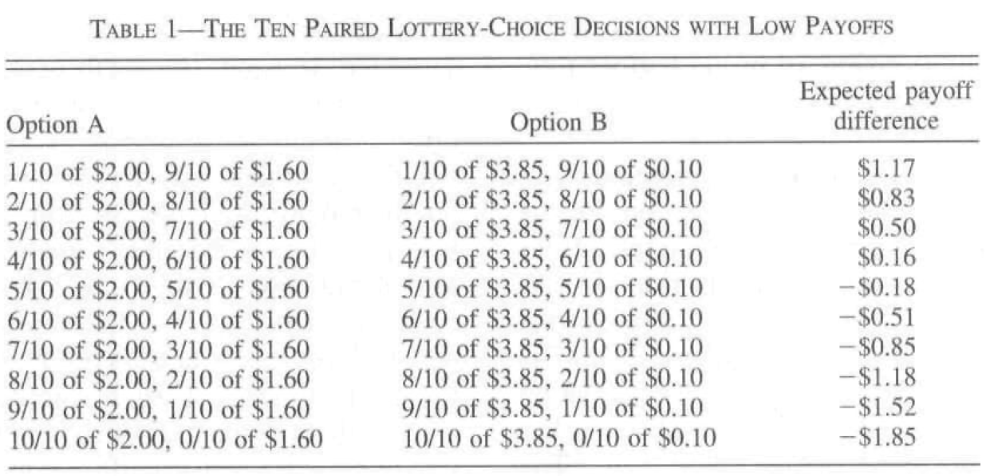
1. Introduction - Holt and Laury (2002) (HL)
Risk aversion measured in which row a person switch from A to B
A risk-neutral person chooses A four times before switching to B
Even the most risk-averse person should switch over by decision 10 in the bottom row

Slide 4
1. Introduction - (HL) con’t
(HL): developed the multiple price list format which is representative and mostly cited, but had some weakness such as
framing effect
probability weighting
stick to parametric utility functions
multiple switching problems
interval response

Slide 5
1. Introduction – attempts to overcome the HL
Quigging (1995), Wakker and Deneffe (1996) and Diecidue and Wakker (2001): generalized non-expected utility theory
Anderson et al. (2006, 2008): corrected the framing effect and interval responses
Bruner (2009), Adellaoui et al. (2011) and Drichoutis and Lust (2012): took rank-dependent utility into account
Maier and Rüger (2010): reward weighting instead of probability weighting
Bosch-Domenech and Silvestre (2013): the coarser elicitation method
Hirscharuer et al. (2014): dropping inconsistent subjects
Dohmen et al. (2011): used representative survey
Charness et al. (2013): review paper

Slide 6
2. Experimental procedure
Subjects: 161 undergraduate students at Dankook University from 6 classes
Preparation
Each subject enters the lab with her own USB to save answers in
She/he answers questionnaires constructed with VB embedded in MS Excel on the monitor
Stage 1: Personal characteristics survey
Sex, age, military service, the number of family members, the number of classes taken in Economics and Finance, religion, and average educational level of parents
Some other characteristics such as GPA, yearly income, double major, the number of times to apply colleges
Cognitive ability: from CRT in Frederick (2005) and WPT(Wonderlic Personnel Test)

Slide 7
2. Experimental procedure
Economic intelligence: 6 introductory questions from Soper and Walstad (1987)
Experience of risky behaviors: lottery purchases, gambles, stock investment, money lending
Subjective propensity to risk: absolute amount of lottery tickets subjects are willing to pay, and subjective risk attitude
Stage 2: Replication of the HL method
It begins with instruction and two sample lottery choices
The HL method (5.1 session): 10 random choices between option A and option B and each option has probability weighting and fixed rewards

Slide 8
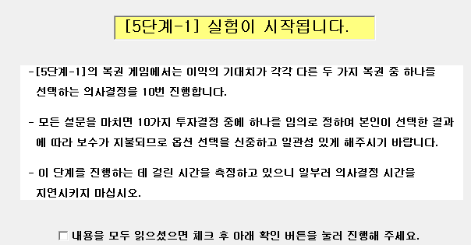
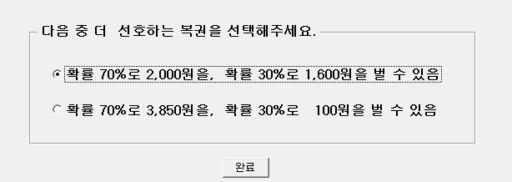
2. Experimental procedure

Slide 9
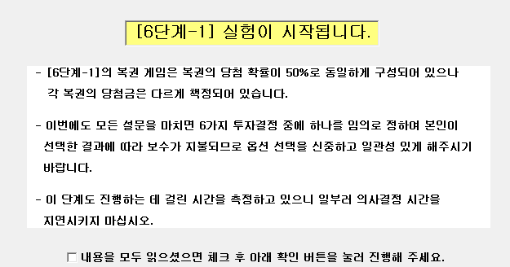
2. Experimental procedure
Stage 3: Main sessions
The first session (6.1): 6 choices between option A and option B, and in each option, there are 2 lottery tickets with changing rewards and probability 1/2

Slide 10
2. Experimental procedure
Table 1 The elicitation method: Multiple price list format
Row No. | Option A Prob. 1/2 Prob. 1/2 Outcome1 Outcome2 | Option B Prob. 1/2 Prob. 1/2 Outcome1 Outcome2 | Range of RRA(r) | EV(B)-EV(A), Var(B)-Var(A)
1 | 2,900 3,100 | 0 4,100 | (-Inf, -1.22] | -950, 4,192,500
2 | 2,900 3,100 | 0 6,000 | [-1.22, 0] | 0, 8,990,000
3 | 2,900 3,100 | 800 5,700 | [0, 0.23] | 250, 2,992,475
4 | 2,900 3,100 | 1,500 5,000 | [0.23, 0.5] | 250, 1,522,125
5 | 2,900 3,100 | 2,000 4,500 | [0.5, 1] | 250, 771,875
6 | 2,900 3,100 | 2,500 4,000 | [1, 3.04] | 250, 271,625

Slide 11
2. Experimental procedure
We construct our price list format.
Subjects make 6 choices between options A and B.
In option B, rewards change, holding the probability constant, 1/2.
Option B is more risky than option A in terms of mean and variance.
Degree of risk in option B rises from the sixth row to the first row.
Ranger of RRA is calculated with .
The coarser classification: 7 ranks of risk aversion, depending on in which row subjects move to B.

Slide 12
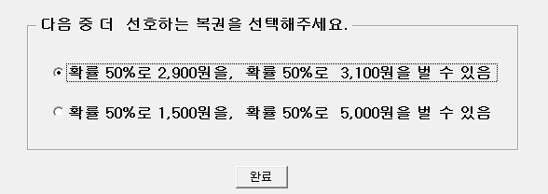
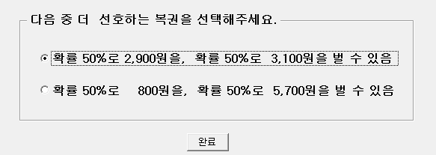
2. Experimental procedure
Subjects choose one option on each 6 pop-up windows which appears randomly as the following

Slide 13
3.1 Advantage of our experiment
Advantages of our experiment are
Independence axiom is valid in the sense that the risk preference is linear in probability
Out method is immune to the probability weighting.
By random selection, our method is free of the framing effect
Due to the coarser classification, we successfully accomplish to reduce noisy decision makers, i.e., multiple switching problems
 | HL(2002) | Step 5-1 | Step 6-1
0 | 1(0.47) | 11 (6.83) | 18 (11.2)
1 | 183(86.3) | 87 (54.0) | 113 (70.2)
2 | 0(0.00) | 9 (5.59) | 8 (4.97)
3 | 21(9.91) | 44 (27.3) | 22 (13.7)
4 | 1(0.47) | 3 (1.86) | 0 (0.00)
5 | 3(1.42) | 4 (2.48) | 0 (0.00)
6 | 1(0.47) | 2 (1.24)
7 | 1(0.47) | 0 (0.00)
8 | 0(0.00) | 0 (0.00)
9 | 1(0.47) | 1 (0.62)
Total obs.(Prob.) | 212(100%) | 161 (100%) | 161 (100%)

Slide 14
3.1 Supplemental process: use of additional information
Now, we supplement the coarser classification with individual risk preferences
While we effectively reduce multiple switching points, we may have too simple risk aversion measure compared to previous studies.
The predictive accuracy may depend on subjects’ numerical skills, so that we have to take heterogeneity into account (Dave et al. (2010))
We supplement our experiment with individual characteristics of past risk behaviors
Make binary variables with respect to experiences of lottery purchases, gambles, stock investment, and money lending, respectively and count the number of experience from 0 to 4.
Categorize subjects into 2 groups, low risk group with 0-2, and high risk group with 3-4 experiences, two groups are almost evenly distributed (0.4969 vs 0.503) .

Slide 15
3.1 Supplemental process (con’t)
Split each rank of risk aversion in the experiment into 2 distinct ranks, hence we have 14 ordered ranks of risk aversion.
Supplemental process is illustrated in Fig. 1
risk
loving
risk
averse
Row 4->Row 5
high group
low group
Row 3->Row 4
high group
low group
Fig 1. Illustration of Ordered Rank of Risk Aversion

Slide 16
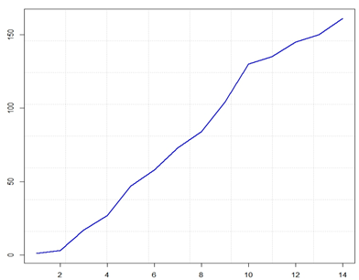
3.1 Ordered risk aversion
By supplemental process,
The measurement depends on only rank of risk aversion, by imposing ‘duality’ stating that the risk averse should choose less risky gambles (Diamond and Stiglitz (1974))
The method makes up the coarser classification with the real observed risk preferences.
Fig. 2 Cumulative Distribution of Ordered Risk Aversion

Slide 17
3.1 Quantile normalization
Third, we standardize ordered rank of risk aversion with quantile normalization
To remove unwanted variations induced from different experimental condition, e.g., different levels of incentives, different laboratories, different environments belonging to subjects etc.
To reduce the effect of the aberrations in the data which distort the estimates in regression analysis of risk aversion
We transform ordered rank of risk aversion to a index by quantile normalization by Bolstad et al. (2003)
The continuity axiom on risk preferences guarantees the existence of the monotone transformation, i.e., rank preserved.

Slide 18
3.1 Quantile normalization (con’t)
By quantile normalization,
The index is generally compatible regardless of experimental circumstances.
Now we complete the index of risk aversion
Fig. 3 Transformation with quantile normalization

Slide 19
3.2 Data
Description of data
Variables | Definition | Min ~ Max
index6.1 | Risk aversion index at session 6.1, quantile normalized
time6.1 | Time spent in session 6.1(unit : sec) | 10 ~ 164
intelligence | IQ test score(6 questions, per 1 point) | 0 ~ 6
Knowledge | Economic knowledge test score(6 questions, per 1 point) | 2 ~ 6
Sex | gender(male 1, female 0)
Age | Age(unit : years old) | 19 ~ 30
Major | Is your major Economics?(yes 1, no 0)
Score | Average grade, previous semester(basis : 4.5 point) | 1.15 ~ 4.5
Military | Military service(yes 1, no 0)
Num.class | How many Economic classes have you taken? | 0 ~ 26
Num.family | Number of family members | 2 ~ 7
Religion | Have you got religion?(yes 1, no 0)
Father | Academic ability of father (college graduate 1, lower 0)
Mother | Academic ability of mother (college graduate 1, lower 0)
Edu.FM | Academic ability of parents(college graduate 1, lower 0)

Slide 20
3.2 Data
Summary statistics
Variables | Mean | Probability(%) |  | St. Dev.
 |  | Value=1 | Value=0
index6.1 | 0.3387 |  |  | 0.9063
time6.1 | 39.4200 |  |  | 22.7573
Intelligence | 4.1740 |  |  | 1.4559
Knowledge | 4.9690 |  |  | 1.0273
Sex |  | 49.07 | 50.93
Age | 22.9400 |  |  | 2.2368
Major |  | 54.04 | 45.96
score | 3.6100 |  |  | 0.5482
military |  | 34.78 | 65.22
Num.class | 8.6340 |  |  | 5.7464
Num.family | 4.0870 |  |  | 0.4532
religion | 0.2857 | 28.57 | 71.43
Father | 0.5714 | 57.14 | 42.86
Mother | 0.3789 | 37.89 | 62.11
Edu.FM | 0.3416 | 34.16 | 65.84

Slide 21
4. Risk aversion and personal characteristics
We discuss how some socio-economic variables and personal characteristics are correlated with risk aversion.
Many studies have been trying to find what determine risk aversion.
Thanks to good traits of the index to overcome interval response, we use the index as dependent variable, and do some regression analyses.
OLS, Interval, Ordered logit, Ordered probit
Quantile regression with bootstrap

Slide 22
4. Risk aversion and personal characteristics
What is quite interesting in regressions is that time is significantly negative in determining risk aversion, which is consistent with the result in section 4.2 in a sense that the more time spent choosing lotteries, the more risk loving.
Table 6 Various Regression Results of Risk Aversion Index Model
 | OLS(Index) |  | OLS(Mid-P) |  | Interval Reg. |  | Ord. Logistic |  | Ord.Probit
Intercept | 1.7186 |  | 3.0421 |  | 1.5372
Time | -0.0111 | *** | -0.0140 | *** | -0.0112 | ** | -0.0244 | *** | -0.0139 | ***
Intelligence | -0.0570 |  | -0.0529 |  | -0.0290 |  | -0.0795 |  | -0.0559
Knowledge | -0.0521 |  | -0.1388 |  | -0.1125 |  | -0.1205 |  | -0.0758
Sex | -0.0765 |  | -0.0796 |  | -0.0975 |  | -0.1656 |  | -0.1066
Age | -0.0510 |  | -0.0674 |  | -0.0496 |  | -0.1157 |  | -0.0582
Major | 0.4136 | ** | 0.5564 | * | 0.5957 | ** | 1.0424 | ** | 0.5313 | **
Score | 0.2851 | ** | 0.3517 |  | 0.4246 | ** | 0.8072 | ** | 0.4435 | **
Military | 0.1398 |  | 0.2970 |  | 0.1729 |  | 0.2594 |  | 0.1704
Num.class | -0.0238 |  | -0.0362 |  | -0.0355 |  | -0.0624 |  | -0.0319
Num.family | -0.0793 |  | -0.1359 |  | -0.0595 |  | -0.0915 |  | -0.0708
Religion | 0.1415 |  | 0.1972 |  | 0.1219 |  | 0.2026 |  | 0.1609
Edu.FM | -0.1500 |  | -0.2099 |  | -0.1212 |  | -0.3168 |  | -0.1800
Note: ***, **, * indicate significance at the level 1%, 5%, and 10% respectively

Slide 23
4. Risk aversion and personal characteristics
Quantile regression
As quantile increases, i.e., the degree of risk aversion increases, the number of significant variables varies
Time is significant in the all percentile, the more time making decisions => the more risk loving
The more intelligent => the more risk loving
Major and Score are significantly meaningful
# of Family is also significantly positive

Slide 24
4. Risk aversion and personal characteristics
Table 7 Quantile Regression Results of Risk Aversion Index Model
 | Tau = 0.1 |  | Tau = 0.25 |  | Tau = 0.5 |  | Tau = 0.75 |  | Tau = 0.9
Intercept | -2.2820 | * | -0.9342 |  | 1.3722 |  | 3.7103 | ** | 5.8096 | ***
Time | -0.0103 | *** | -0.0094 | *** | -0.0066 | ** | -0.0137 | *** | -0.0117 | **
Intelligence | -0.1042 | ** | 0.0134 |  | -0.0104 |  | -0.0950 | * | -0.1281 | ***
Knowledge | -0.0741 |  | -0.0973 | ** | 0.0057 |  | -0.0447 |  | 0.0516
Sex | 0.0487 |  | -0.1253 |  | -0.1975 |  | -0.0609 |  | -0.0631
Age | 0.0674 |  | -0.0184 |  | -0.0685 |  | -0.1045 |  | -0.0885
Major | 0.5593 | *** | 0.7283 | *** | 0.3865 | ** | 0.6787 | *** | 0.2644
Score | 0.5374 | *** | 0.6073 | *** | 0.3779 | ** | 0.2726 |  | -0.2365 | **
Military | -0.3051 |  | 0.1576 |  | 0.0591 |  | 0.2947 |  | 0.2271
Num.class | -0.0369 | * | -0.0525 | *** | -0.0173 |  | -0.0386 | * | -0.0414
Num.family | 0.4095 | ** | 0.2093 | ** | -0.0016 |  | 0.0675 |  | 0.3104 | ***
Religion | -0.1472 | ** | -0.0372 |  | -0.1371 |  | -0.0606 |  | -0.1612
Edu.FM | -0.1449 |  | -0.2251 | ** | -0.1455 |  | -0.3500 | ** | -0.2450 | *
Note: ***, **, * indicate significance at the level 1%, 5%, and 10% respectively

Slide 25
4. Risk aversion and personal characteristics
Fig. 7 Quantile Regression Estimates for Risk Aversion Index Model( ranges from 0.1 to 0.9 )

Slide 26
5. Conclusion
We propose the new index of measuring risk aversion which depends on ordering of risk attitude and quantile standardization so that it has good traits. It overcomes the framing effect and the multiple switching problems and doesn't utilize any specific utility function or probability weighting.
While we elicit risk aversion and create the new index in a innovative way, we still need more back-up theories and more reasonable explanations in interpreting the rank preserving in our method, and should elaborate behavioral theories and design new experiments to fully shed light on the effect of time reduction on risk aversion.

